Slide 1

YSR ENGINEERING COLLEGE OF YVU
Project Presentation
On
Improved Advanced Encryption Standard (AES) Algorithm
-with additional “AddRoundKey”
Under Guidance Of:
T MUKTHAR AHAMED
Presenting by:
D.LOKESH
K.SASIREKHA
K.MADHUSUDHAN
G.DEVENDRA
L.PRAVEEN KUMAR

Slide 2
Topics
Abstract
Introduction
Basic AES
AES Key Scheduling
AES Round Operations
Modified AES algorithm
Results
Conclusion
Future Scope

Slide 3
Abstract
The Advanced Encryption Standard (AES) is a widely-used symmetric encryption algorithm that provides secure and efficient data encryption. However, there is always a need to improve the security and performance of cryptographic algorithms to meet the increasing demands of secure communication and data protection. In this project a modified AES encryption algorithm is proposed using an additional AddRoundKey operation. The additional AddRoundKey operation in between ShiftRows and the MixColumns operation, which can provide an additional level of diffusion and improve the security of the encryption. The modified AES encryption algorithm is tested against standard AES encryption algorithm using a variety of test vectors. Test results shows that the modified AES algorithm has better Avalanche effect compared to the standard AES algorithm. The modified AES algorithm provides improved diffusion and confusion properties than standard AES encryption algorithm, which can make it more secure against certain types of attacks.
Keywords: Standard AES , Modified AES, AddRoundKey, Avalanche effect, Diffusion, confusion.

Slide 4
1.Introduction
As DES is widely used symmetric encryption algorithm but there is
always a need to improve the security of cryptographic algorithms to meet
the increasing demands of secure communication and data protection.
A replacement for DES was needed because
DES Key size is too small
DES is slow
Can use Triple-DES – but slow, small block
US NIST issued call for ciphers in 1997
15 candidates accepted in Jun 98
5 were shortlisted in Aug 99
Notes:
The Advanced Encryption Standard (AES) was published by NIST (National Institute of Standards and Technology) in 2001. AES is a symmetric block cipher that is intended to replace DES as the approved standard for a wide range of applications. The AES cipher (& other candidates) form the latest generation of block ciphers, and now we see a significant increase in the block size - from the old standard of 64-bits up to 128-bits; and keys from 128 to 256-bits. In part this has been driven by the public demonstrations of exhaustive key searches of DES. Whilst triple-DES is regarded as secure and well understood, it is slow, especially in s/w. In a first round of evaluation, 15 proposed algorithms were accepted. A second round narrowed the field to 5 algorithms. NIST completed its evaluation process and published a final standard (FIPS PUB 197) in November of 2001. NIST selected Rijndael as the proposed AES algorithm. The two researchers who developed and submitted Rijndael for the AES are both cryptographers from Belgium: Dr. Joan Daemen and Dr.Vincent Rijmen.

Slide 5
AES Competition Requirements
Private key symmetric block cipher
128-bit data, 128/192/256-bit keys
Stronger & faster than Triple-DES
Provide full specification & design details
Both C & Java implementations
Notes:
Listed above are NIST’s requirements for the AES candidate submissions. These criteria span the range of concerns for the practical application of modern symmetric block ciphers.

Slide 6
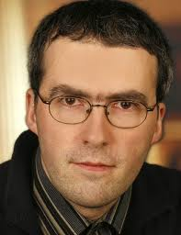

The AES Cipher - Rijndael
Rijndael was selected as the AES in Oct-2000
Designed by Vincent Rijmen and Joan Daemen in Belgium
Issued as FIPS PUB 197 standard in Nov-2001
An iterative rather than Feistel cipher
processes data as block of 4 columns of 4 bytes (128 bits)
operates on entire data block in every round
Rijndael design:
simplicity
has 128/192/256 bit keys, 128 bits data
resistant against known attacks
speed and code compactness on many CPUs
V. Rijmen
J. Daemen
Notes:
The Rijndael proposal for AES defined a cipher in which the block length and the key length can be independently specified to be 128,192,or 256 bits. The AES specification uses the same three key size alternatives but limits the block length to 128 bits. Rijndael is an academic submission, based on the earlier Square cipher, from Belgium academics Dr Joan Daemen and Dr Vincent Rijmen. It is an iterative cipher (operates on entire data block in every round) rather than feistel (operate on halves at a time), and was designed to have characteristics of: Resistance against all known attacks, Speed and code compactness on a wide range of platforms, & Design simplicity.

Slide 7
Implementation Aspects
The algorithms used in AES are so simple that they can be easily
implemented using cheap processors and a minimum amount of memory.
Very efficient
Implementation was a key factor in its selection as the AES cipher
Notes:
AES can also be very efficiently implemented on an 32-bit processor, by rewriting the stage transformation to use 4 table lookups & 4 XOR’s per column of state. These tables can be computed in advance using the formulae shown in the text, and need 4Kb to store.
The developers of Rijndael believe that this compact, efficient implementation was probably one of the most important factors in the selection of Rijndael for AES.

Slide 8
AES Security
AES was designed after DES.
Most of the known attacks on DES were already tested on AES.
Brute-Force Attack
AES is definitely more secure than DES due to the larger-size key.
Statistical Attacks
Numerous tests have failed to do statistical analysis of the ciphertext
Differential and Linear Attacks
There are no differential and linear attacks on AES as yet.

Slide 9
2.Basics of AES
Plaintext (128 bits)
AES
Key (128-256 bits)
Ciphertext (128 bits)

Slide 10
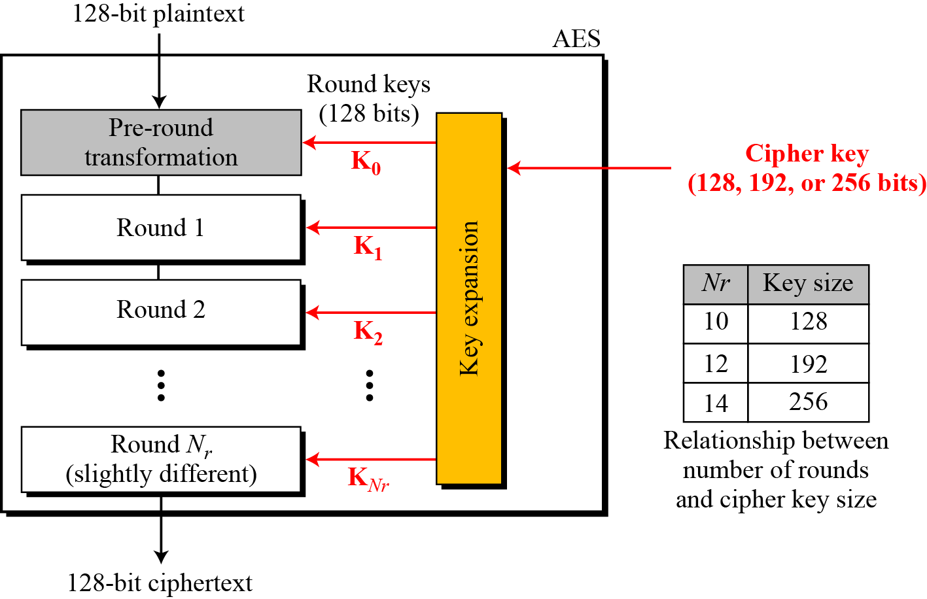
Multiple rounds
Rounds are (almost) identical
First and last round are a little different
Notes:
The input to the AES encryption and decryption algorithms is a single 128-bit block, depicted in FIPS PUB 197, as a square matrix of bytes .This block is copied into the State array, which is modified at each stage of encryption or decryption. After the final stage, State is copied to an output.
The key is expanded into 44/52/60 lots of 32-bit words (see later), with 4 used in each round.
The data computation then consists of an “add round key” step, then 9/11/13 rounds with all 4 steps, and a final 10th/12th/14th step of byte subs + mix cols + add round key. This can be viewed as alternating XOR key & scramble data bytes operations. All of the steps are easily reversed, and can be efficiently implemented using XOR’s & table lookups.

Slide 11
High Level Description
Key Expansion
Round keys are derived from the cipher key using Rijndael's key schedule
Initial Round
AddRoundKey : Each byte of the state is combined with the round key using bitwise xor
Rounds
SubBytes : non-linear substitution step
ShiftRows : transposition step
MixColumns : mixing operation of each column.
AddRoundKey
Final Round
SubBytes
ShiftRows
AddRoundKey
No MixColumns
Notes:
The input to the AES encryption and decryption algorithms is a single 128-bit block, depicted in FIPS PUB 197, as a square matrix of bytes .This block is copied into the State array, which is modified at each stage of encryption or decryption. After the final stage, State is copied to an output.
The key is expanded into 44/52/60 lots of 32-bit words (see later), with 4 used in each round.
The data computation then consists of an “add round key” step, then 9/11/13 rounds with all 4 steps, and a final 10th/12th/14th step of byte subs + mix cols + add round key. This can be viewed as alternating XOR key & scramble data bytes operations. All of the steps are easily reversed, and can be efficiently implemented using XOR’s & table lookups.

Slide 12
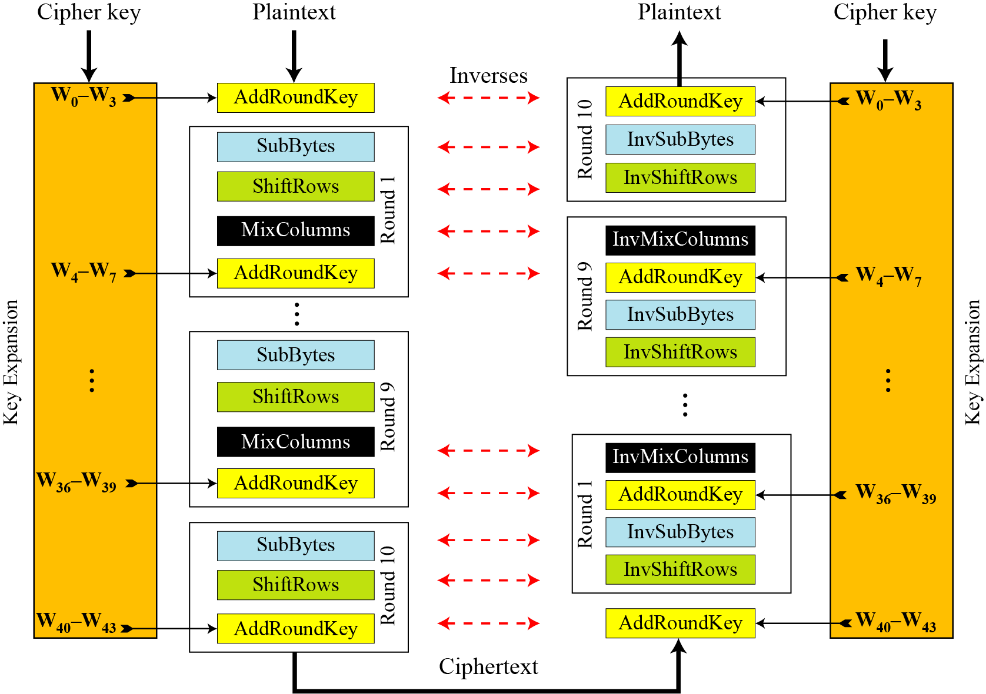
Architecture
Notes:
Stallings Figure 5.1 shows the overall structure of AES, as detailed on the previous slide.

Slide 13
128-bit values
Data block viewed as 4-by-4 table of bytes
Represented as 4 by 4 matrix of 8-bit bytes.
Key is expanded to array of 32 bits words
1 byte

Slide 14
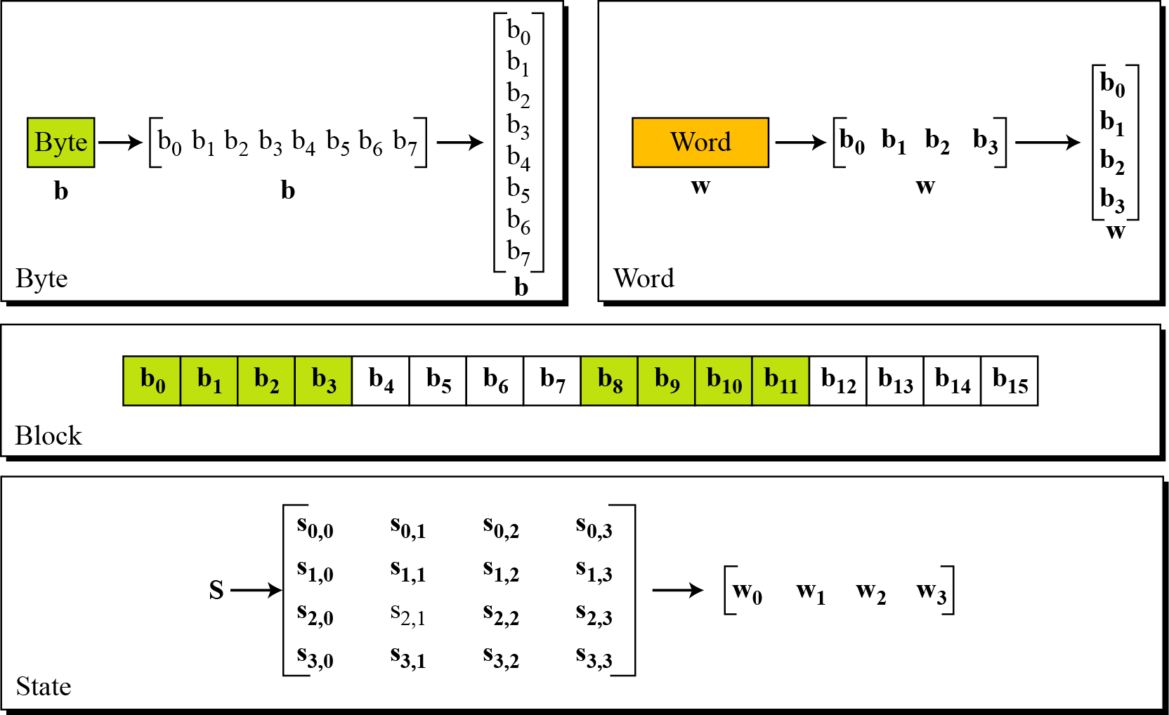
Data Unit

Slide 15
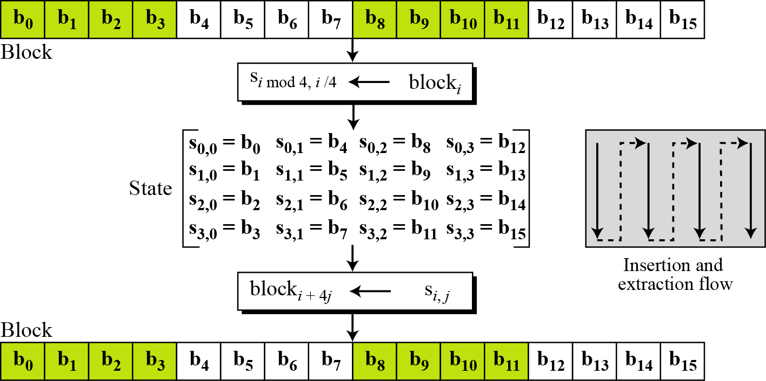
Unit Transformation

Slide 16
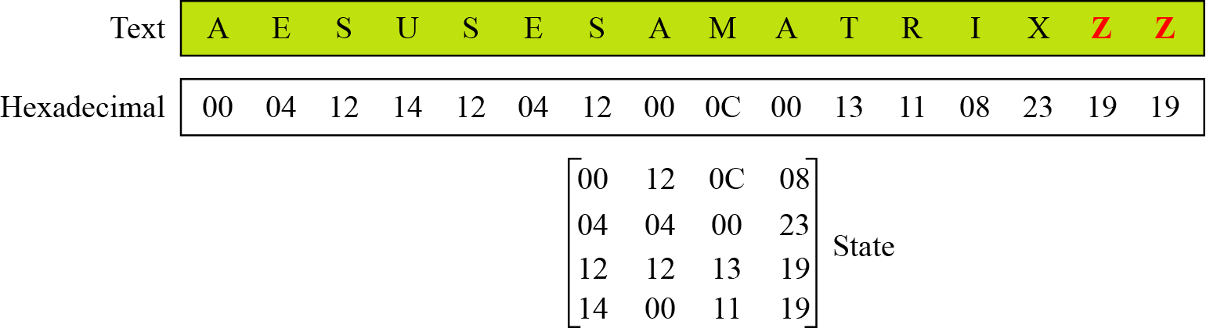
Changing Plaintext to State

Slide 17
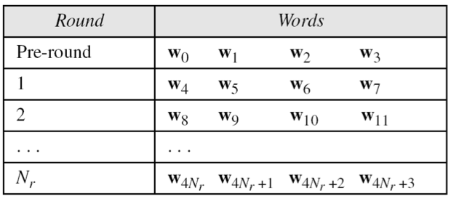
3.AES Key Scheduling
Takes 128-bits (16-bytes) key and expands into array of 44 32-bit words
Notes:
The AES key expansion algorithm takes as input a 4-word (16-byte) key and produces a linear array of words, providing a 4-word round key for the initial AddRoundKey stage and each of the 10/12/14 rounds of the cipher. It involves copying the key into the first group of 4 words, and then constructing subsequent groups of 4 based on the values of the previous & 4th back words. The first word in each group of 4 gets “special treatment” with rotate + S-box + XOR constant on the previous word before XOR’ing the one from 4 back. In the 256-bit key/14 round version, there’s also an extra step on the middle word.

Slide 18
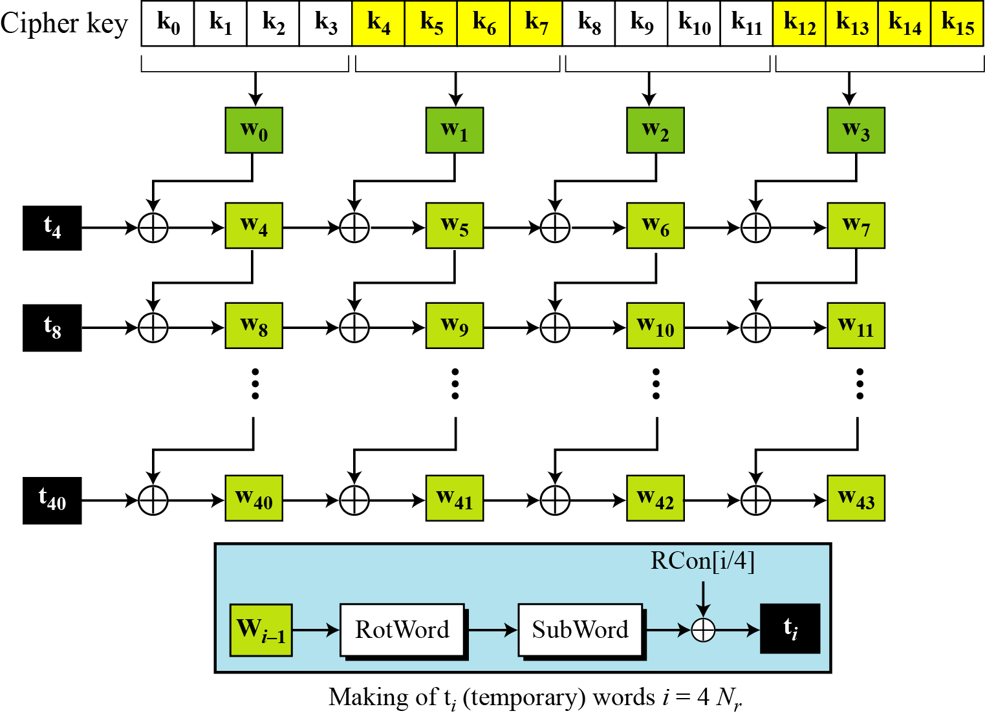
Key Expansion Scheme

Slide 19
Key Expansion submodule
RotWord performs a one byte circular left shift on a word For example:
RotWord[b0,b1,b2,b3] = [b1,b2,b3,b0]
SubWord performs a byte substitution on each byte of input word using the S-box
SubWord(RotWord(temp)) is XORed with RCon[j] – the round constant

Slide 20
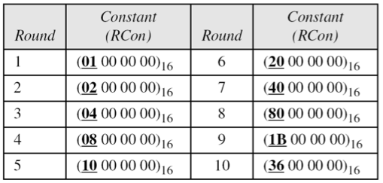
Round Constant (RCon)
RCON is a word in which the three rightmost bytes are zero
It is different for each round and defined as:
RCon[j] = (RCon[j],0,0,0)
where RCon[1] =1 , RCon[j] = 2 * RCon[j-1]
Multiplication is defined over GF(2^8) but can be implement in Table Lookup

Slide 21
Key Expansion Example (1st Round)
Example of expansion of a 128-bit cipher key
Cipher key = 2b7e151628aed2a6abf7158809cf4f3c
w0=2b7e1516 w1=28aed2a6 w2=abf71588 w3=09cf4f3c
i | w_{i-1} | RotWord | SubWord | Rcon[i/4] | t_{i} | w[i-4] | w_{i}
4 | 09cf4f3c | cf4f3c09 | 8a84eb01 | 01000000 | 8b84eb01 | 2b7e1516 | a0fafe17
5 | a0fafe17 | - | - | - | - | 28aed2a6 | 88542cb1
6 | 88542cb1 | - | - | - | - | Abf71588 | 23a33939
7 | 23a33939 | - | - | - | - | 09cf4f3c | 2a6c7605

Slide 22
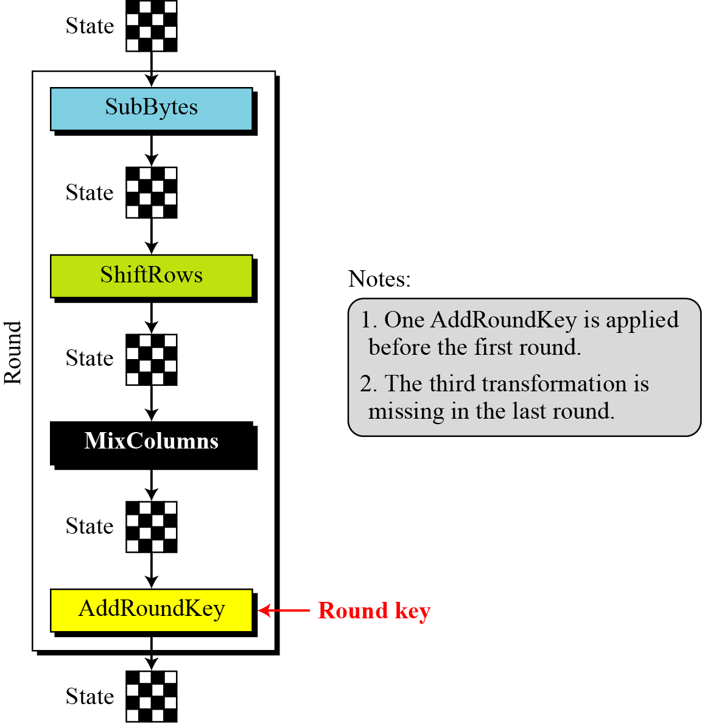
4.AES Round Operations

Slide 23
SubBytes: Byte Substitution
A simple substitution of each byte
provide a confusion
Uses one S-box of 16x16 bytes containing a permutation of all 256 8-bit values
Each byte of state is replaced by byte indexed by row (left 4-bits) &
column (right 4-bits)
eg. byte {95} is replaced by byte in row 9 column 5
which has value {2A}
S-box constructed using defined transformation of values in Galois Field- GF(2⁸)
Notes:
Now discuss each of the four stages used in AES. The Substitute bytes stage uses an S-box to perform a byte-by-byte substitution of the block. There is a single 8-bit wide S-box used on every byte. This S-box is a permutation of all 256 8-bit values, constructed using a transformation which treats the values as polynomials in GF(2⁸) – however it is fixed, so really only need to know the table when implementing. Decryption requires the inverse of the table. These tables are given in Stallings Table 4.5.
The table was designed to be resistant to known cryptanalytic attacks. Specifically, the Rijndael developers sought a design that has a low correlation between input bits and output bits, with the property that the output cannot be described as a simple mathematical function of the input, with no fixed points and no “opposite fixed points”.

Slide 24
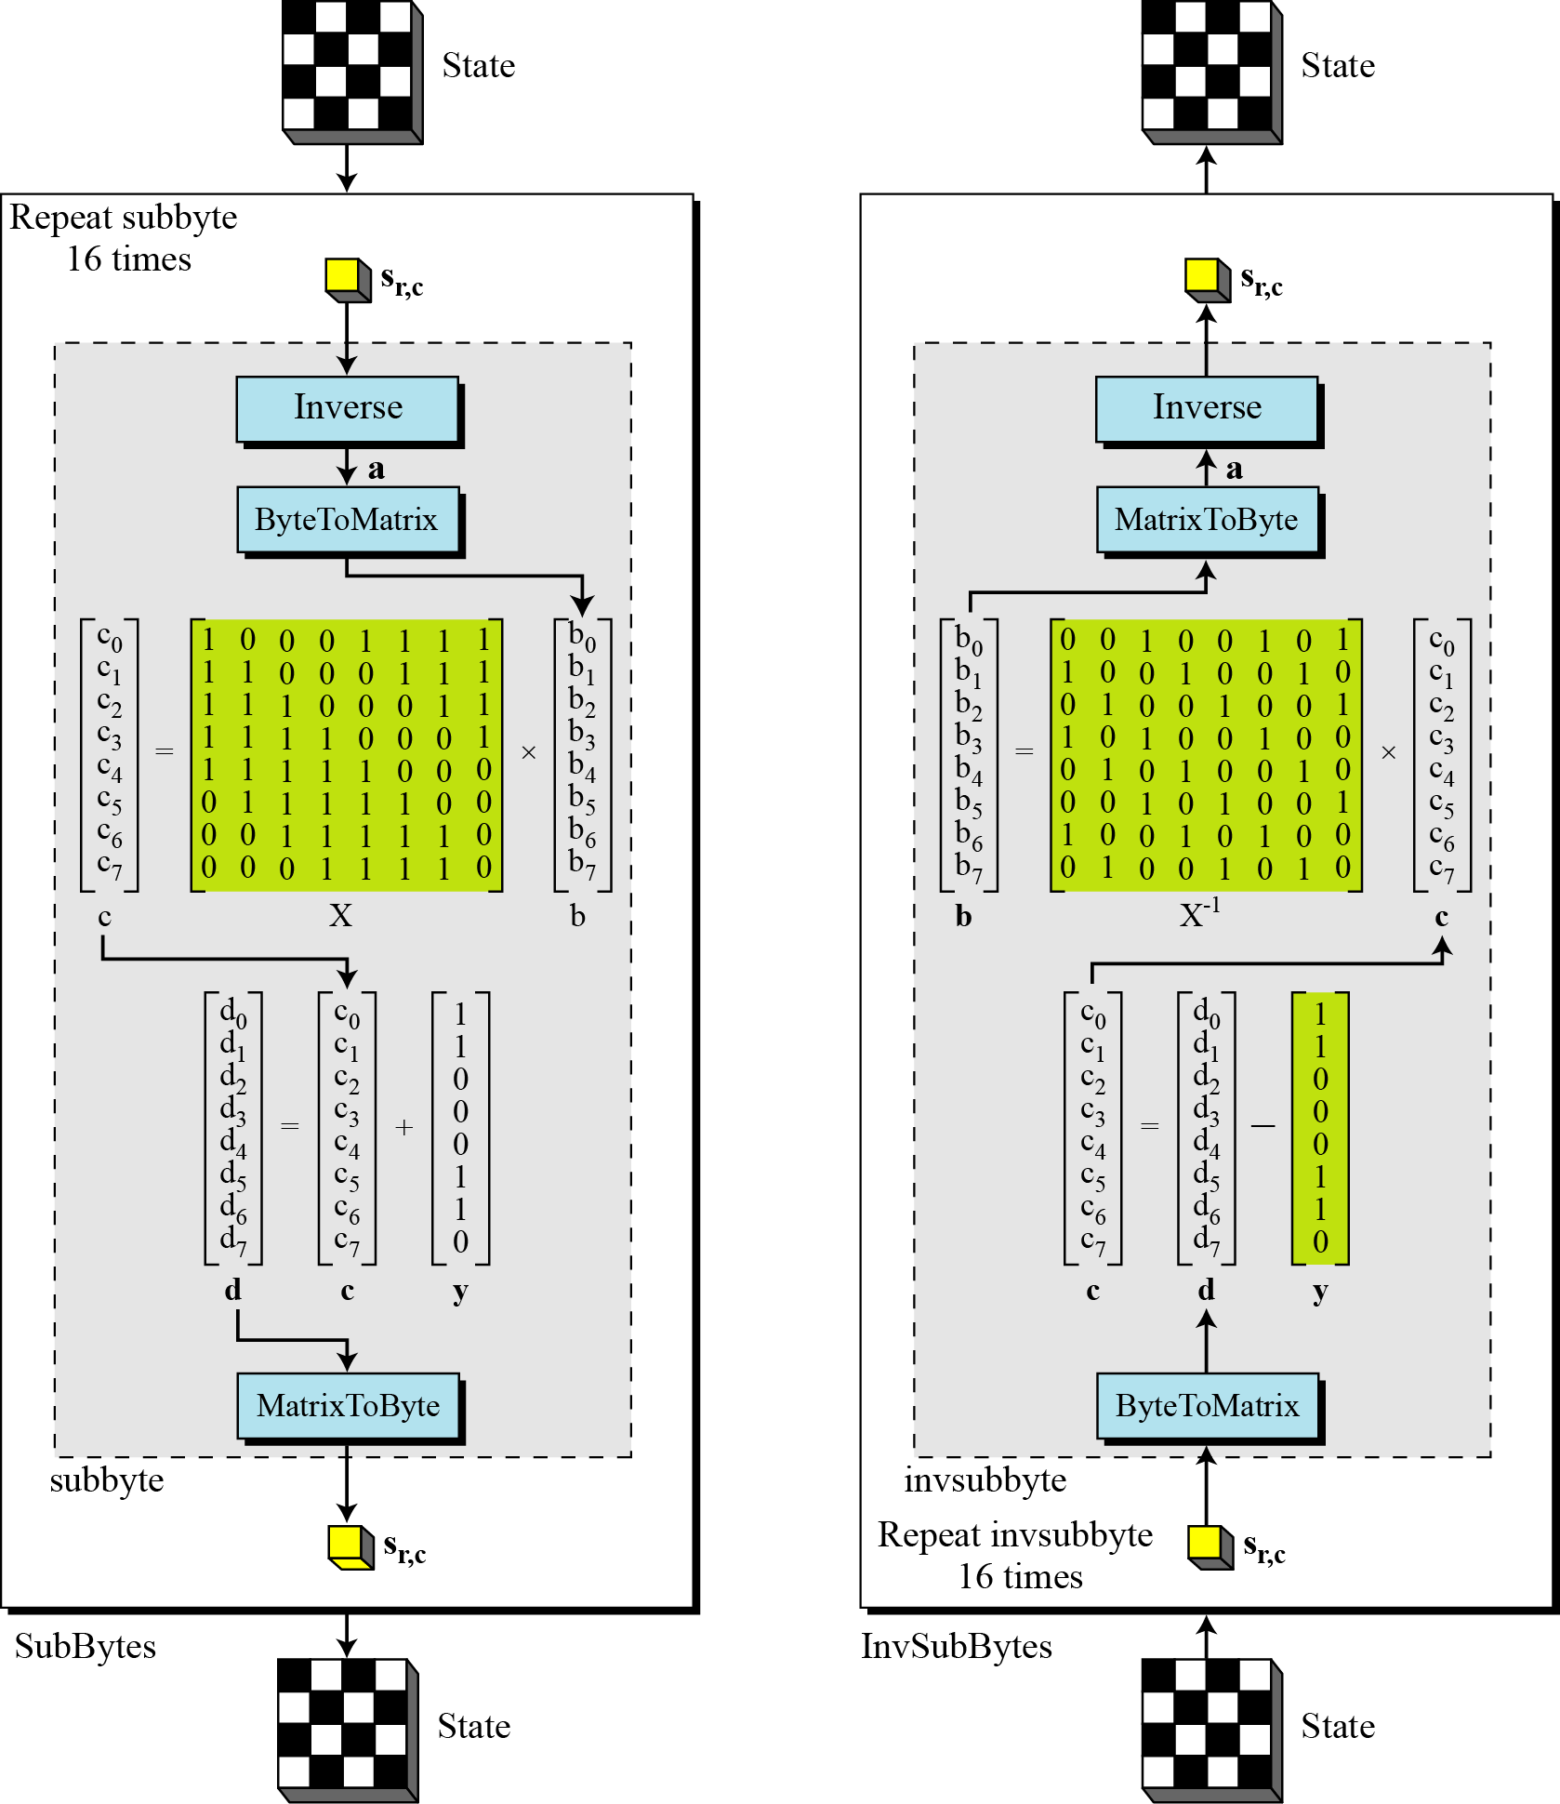
SubBytes and InvSubBytes

Slide 25
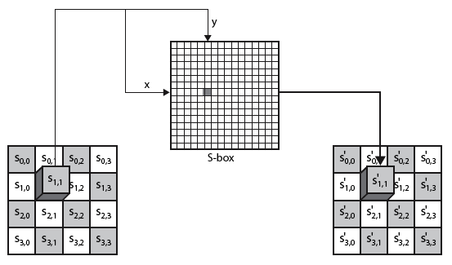
SubBytes Operation
The SubBytes operation involves 16 independent byte-to-byte transformations.
Interpret the byte as two hexadecimal digits xy
SW implementation, use row (x) and column (y) as lookup pointer
S_{1,1} = xy₁₆
x’y’₁₆

Slide 26
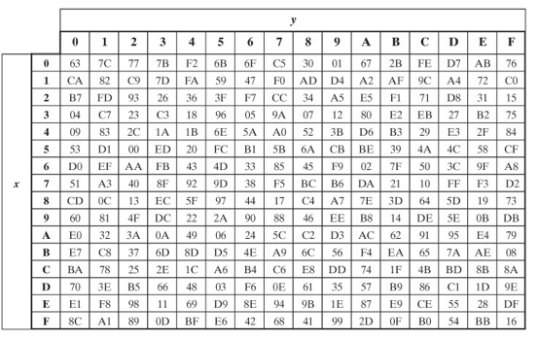
SubBytes Table
Implement by Table Lookup

Slide 27
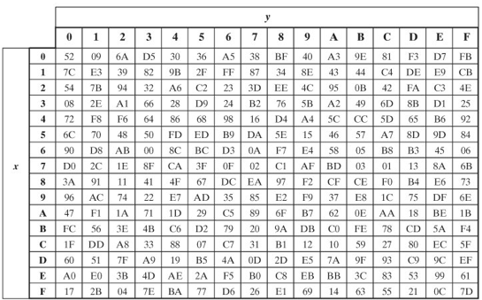
InvSubBytes Table

Slide 28
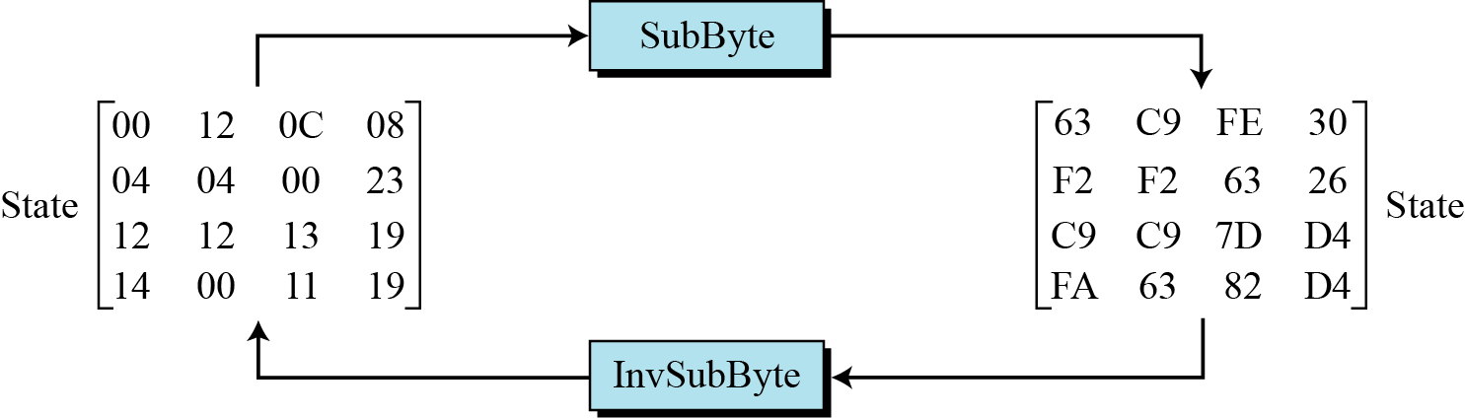
Sample SubByte Transformation
The SubBytes and InvSubBytes transformations are inverses of each other.

Slide 29
ShiftRows
Shifting, which permutes the bytes.
A circular byte shift in each each
1st row is unchanged
2nd row does 1 byte circular shift to left
3rd row does 2 byte circular shift to left
4th row does 3 byte circular shift to left
In the encryption, the transformation is called ShiftRows
In the decryption, the transformation is called InvShiftRows and the shifting is to the right
Notes:
The ShiftRows stage provides a simple “permutation” of the data, whereas the other steps involve substitutions. Further, since the state is treated as a block of columns, it is this step which provides for diffusion of values between columns. It performs a circular rotate on each row of 0, 1, 2 & 3 places for respective rows. When decrypting it performs the circular shifts in the opposite direction for each row. This row shift moves an individual byte from one column to another, which is a linear distance of a multiple of 4 bytes, and ensures that the 4 bytes of one column are spread out to four different columns.

Slide 30
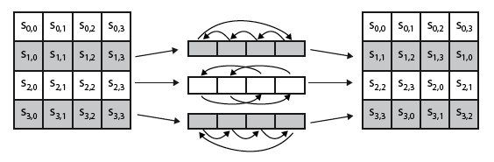
ShiftRows Scheme
Notes:
Stalling Figure 5.5a illustrates the Shift Rows permutation.

Slide 31
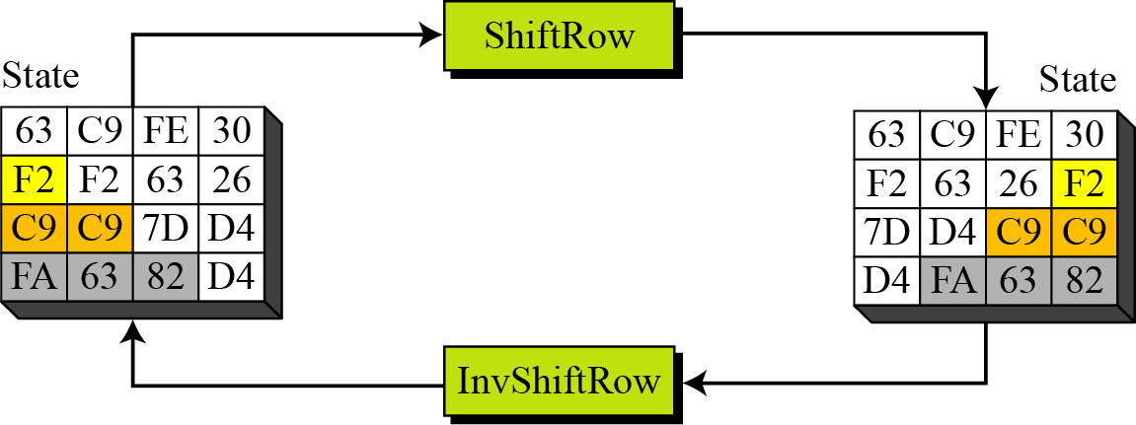
ShiftRows and InvShiftRows

Slide 32
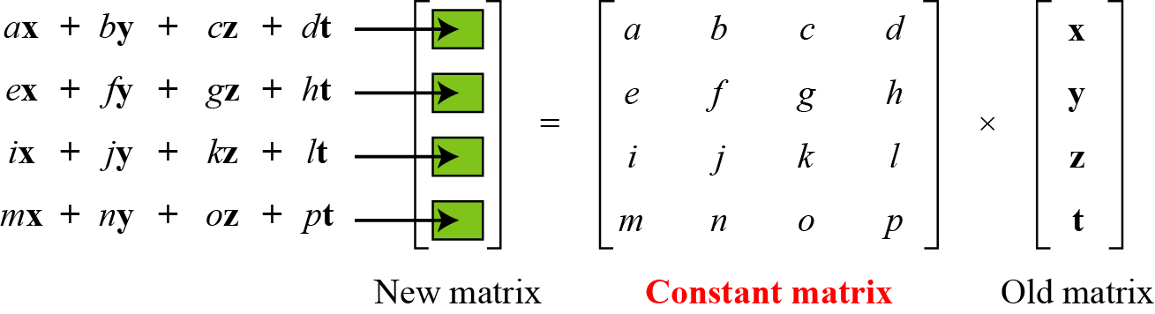
MixColumns
ShiftRows and MixColumns provide diffusion to the cipher
Each column is processed separately
Each byte is replaced by a value dependent on all 4 bytes in the column
Effectively a matrix multiplication in GF(2⁸) using prime poly m(x) =x⁸+x⁴+x³+x+1
Notes:
The MixColumns stage is a substitution that makes use of arithmetic over GF(2^8). Each byte of a column is mapped into a new value that is a function of all four bytes in that column. It is designed as a matrix multiplication where each byte is treated as a polynomial in GF(2⁸). The inverse used for decryption involves a different set of constants.
The constants used are based on a linear code with maximal distance between code words – this gives good mixing of the bytes within each column. Combined with the “shift rows” step provides good avalanche, so that within a few rounds, all output bits depend on all input bits.

Slide 33
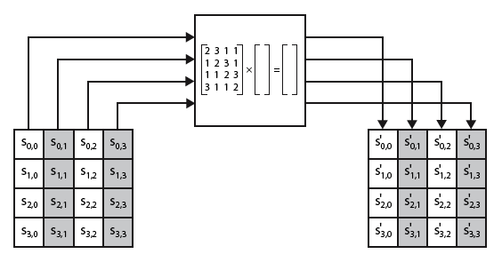
MixColumns Scheme
The MixColumns transformation operates at the column level; it transforms each column of the state to a new column.
Notes:
Stalling Figure 5.5b illustrates the Mix Columns transformation.
In practise, you implement Mix Columns by expressing the transformation on each column as 4 equations (Stallings equation 5.4) to compute the new bytes for that column. This computation only involves shifts, XORs & conditional XORs (for the modulo reduction).
The decryption computation requires the use of the inverse of the matrix, which has larger coefficients, and is thus potentially a little harder & slower to implement.
The designers & the AES standard provide an alternate characterisation of Mix Columns, which treats each column of State to be a four-term polynomial with coefficients in GF(2⁸). Each column is multiplied by a fixed polynomial a(x) given in Stallings eqn 5.7. Whilst this is useful for analysis of the stage, the matrix description is all that’s required for implementation.

Slide 34
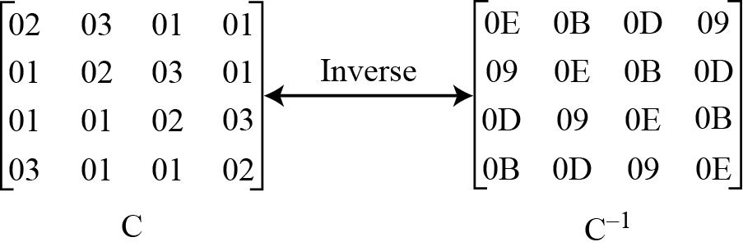
MixColumn and InvMixColumn

Slide 35
AddRoundKey
XOR state with 128-bits of the round key
AddRoundKey proceeds one column at a time.
adds a round key word with each state column matrix
the operation is matrix addition
Inverse for decryption identical
since XOR own inverse, with reversed keys
Designed to be as simple as possible
Notes:
Lastly is the Add Round Key stage which is a simple bitwise XOR of the current block with a portion of the expanded key. Note this is the only step which makes use of the key and obscures the result, hence MUST be used at start and end of each round, since otherwise could undo effect of other steps. But the other steps provide confusion/diffusion/non-linearity. That us you can look at the cipher as a series of XOR with key then scramble/permute block repeated. This is efficient and highly secure it is believed.

Slide 36
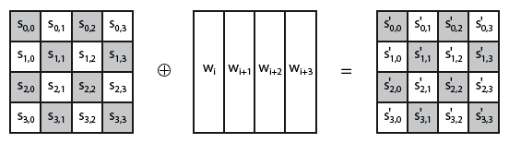
AddRoundKey Scheme
Notes:
Stallings Figure 5.4b illustrates the Add Round Key stage, which like Byte Substitution, operates on each byte of state independently.

Slide 37
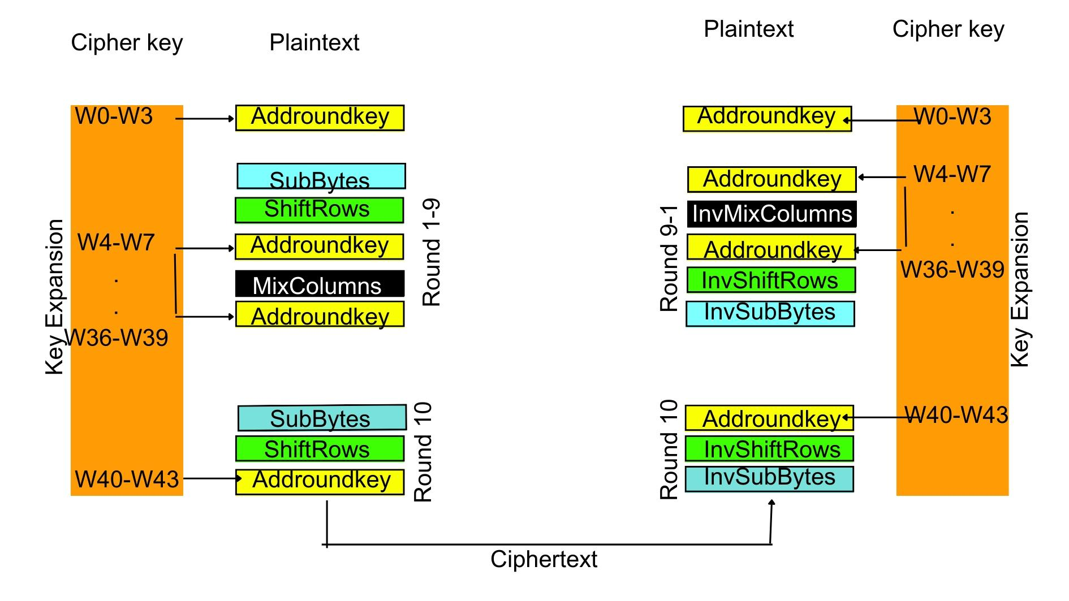
5.Modified AES algorithm
Architecture

Slide 38
Added AddRoundKey
The main modification done to AES is by adding an extra AddRoundKey before Mixcolumns in the Round 1 to 9.
By adding an extra AddRoundKey operation before MixColumns, an additional layer of diffusion and non-linearity is added to the algorithm.
This could potentially increase the security of the algorithm by making it more resistant to attacks that rely on analyzing the output of the algorithm with small changes to the input or key.

Slide 39
Results:
Avalanche Effect due to one bit change in plaintext
It is primary objective to apply avalance effect on modified AES algorithm and standard AES algorithm due to one bit change in the plaintext.
20 testcases are evaluated to compare avalanche effect due to 1 bit change in plaintext between standard AES and modified AES.
Results show that modified AES has better avalanche effect which means that it is difficult to cryptanalysis to make predicitions about the input.

Slide 40
Table: samples of ciphertext and avalanche effect due to change in 1 bit change in plaintext
Sl.no | plaintext | key | Standered AES cipher due to 1bit change in plaintext | Modified AES cipher due to 1bit change in plaintext | Standard AES avalanche % | Modified AES avalanche%
1 | 57CDDD3D3A8A682810CA0DA088C99956 | 99FAFBBE766CD2C62BD1886209305EDE | 1574C663F1F3AA344DDC944EFC33F4C0 | 9B6F513453EC26FB892A24CFB2A0B086 | 48.4375 | 59.375
2 | 0462A3030F59435CE0BEC73259D7E79E | AC8D053896EA55DA573EEF93A280DE4C | 80177093DBB598A3C9155314FA201E1C | 4EAA6E1CECB4D76A76E366517F3346BA | 49.21875 | 51.5625
3 | 97B085DF0CB2F43609DF3CE62938F47D | D678D14ABA848000CF5782B1C6FCDD8D | EABE88388EC8793D73E2B2C9240DD792 | E16CFF0032ED8E3A8083C8419C65D694 | 46.09375 | 55.46875
4 | D6C55981CF8E8D5A5E87C4AD96B6441D | 9E39E526EA504B119A8A9C771A3F010F | B9DC8016B60351D317DF2928E5CFC137 | 23CA43AC32D660F27485E84878CBF7DE | 46.09375 | 47.65625
5 | 8C707E118B719841D4CFF00B154808A5 | 6265EA9EB75C229E08F9DE2C59D40314 | FE1EA81E7E48C5377AB269D8DD82450F | 7744FED91B859F391B4960C1812C4F57 | 43.75 | 45.3125
6 | AB76FBB78AA13BEFBC7872AA741616D1 | 2B5EB0C5C5DCF75D186FAF5347D0968D | B43B20053AAA4AA94E302A8387009E38 | AF11C5ABA4EE85E850E1F80D7468B306 | 46.875 | 50
7 | 5051BC450D6961A1AC2A621057C2CCF5 | 5CEAB897D44EB925EE43215BF16AEBF1 | 28E7BF1F3895E55942990DAD874C0C78 | 56E681C299250168051E1F7C8924F60F | 47.65625 | 54.6875
8 | 5ABA31C838FF5117278AC7C4DEA2C283 | 2F59832DB44DD72068D0D84D7FF4E2D3 | 7A925D65349299F08DA49DE4E188B12E | 00C3399FED71A24A6EE2989C1C23C0A9 | 52.34375 | 55.46875
9 | C53705C34F76FB9F8B376EAADE174DAA | 42BDF4E1B4BAB06A2303B877DCD8958F | 93408A0324D51565073DCA06A008B771 | 585DF770EA162C30BE4C2F119E3F5D07 | 42.1875 | 46.875
10 | 630B84E5ACB37C36A39F73FDD51C826D | 9175D1243E2EA0AF0CF7E675C0851877 | 31B9CB8FB591AB8CAD8CB2A111785610 | C232F740BB4191643AE2E848A8A63565 | 46.09375 | 47.65625

Slide 41
Sl.no | plaintext | key | Standered AES cipher due to 1bit change in plaintext | Modified AES cipher due to 1bit change in plaintext | Standard AES avalanche % | Modified AES avalanche%
11 | A3454EC2E7E6A19AE1F6B155BF73AFBE | 32CC4C0D258520D425FBEFDD33527BC4 | 78846927C5D08636D9B0847C39EAA8D3 | 009BF3C0F7D87CB9FF2ADB953C264351 | 49.21875 | 58.59375
12 | 6871D09F052DB2C3BEEEB55D08ED4FD1 | F28B17FF2C1BD57ED5026DA69AC13C24 | 453369C89488356BDC962E4802EB54ED | 069ADD35AEAD53F986C6E91F1D8C29D6 | 43.75 | 53.125
13 | 2837F725D1783221F78145D68FCDF1FE | 3EA4565DBC5DF9A4862A1A0F504336E7 | 00CA3C6ACE1BCA795C42812C43F3F8DE | 86FAE9F55574E2B808BDFD3CF39F0038 | 46.09375 | 51.5625
14 | 71E633D22D2677F1463E619B3018C9CD | 3C539652AF4874722CC7C49B53B8AEF4 | 8FFF994423A0C4A547C60E82BDACEBB3 | EF1A794598B08ADA7D7B7A807D736B7D | 45.3125 | 46.09375
15 | E3D3CFEA4130C82CB0A2485F76920B8D | A649054E04B062233804AB6E472D329A | 6DCC05D84021AFE06C07BF9EEB408058 | D2432CE4FB07A4189C7EF575DF2BB032 | 52.34375 | 54.6875
16 | AF2B9C0EA8E0DEF41B24481ACFA08CBA | 40AD91974428DCA4F7C6CB099A048AEA | F64353508A940A85BEE06A0EC984F176 | F41803EF75982CEBB640A07A357C09B7 | 41.40625 | 50
17 | D711A421DC7B5AA9F42AABEA10158C8A | CB1A603B0B5A697568B5BD5F928BD845 | C84AA65CF4C286036BD9C28B42F1EE05 | DEACDAA2D1CFC9B9C6A3CC06C8D9A7F8 | 47.65625 | 55.46875
18 | 4F0E24E41DF459F7F3EFC3FE87A692A7 | C219DA2A16E494DDDAC4A8AC564F70BA | 0940989840540D37515634BA1F5D654E | 8D119D6490EF6D3D32D8C6438BF29822 | 45.3125 | 50
19 | 313FBBAE81384B19C7FE4F888F99AE55 | D3FD568D71A491F2640652DE0C947334 | 63910B16D142B4B9B36D5A5B6BAE0066 | F7E180CE48F7DF915C8A2F0638698C6A | 49.21875 | 52.34375
20 | 30AB028DA58124DE29F45ACB93E8850A | 8C3CE8BF06CB7CEE7467B7F2A1EB8926 | 0AB33F3CB6C84BC80E9D91AC11C30452 | E32840BDB33F6612769C8F8947E7EACC | 45.3125 | 46.875

Slide 42
Figure: Represents Avalanche Effect of Modified AES -128 VS Standard AES-128 due to 1bit change in plaintext

Slide 43
Avalanche Effect due to one bit change in key
It is primary objective to apply avalance effect on modified AES algorithm and standard AES algorithm due to one bit change in the key.
20 testcases are evaluated to compare avalanche effect due to 1 bit change in key between standard AES and modified AES.
Results show that modified AES has better avalanche effect which means that it is difficult to cryptanalysis to make predicitions about the key.

Slide 44
Table: samples of ciphertext and avalanche effect due to change in 1 bit change in key
Sl.no | plaintext | key | Standered AES cipher due to 1bit change in key | Modified AES cipher due to 1bit change in key | Standard AES avalanche % | Modified AES avalanche%
1 | 57CDDD3D3A8A682810CA0DA088C99956 | 99FAFBBE766CD2C62BD1886209305EDE | F26844233E5A48576D2548EDAECF2CE7 | 226BB633E216310A32413D8C1EAF74A5 | 44.53125 | 53.90625
2 | 0462A3030F59435CE0BEC73259D7E79E | AC8D053896EA55DA573EEF93A280DE4C | 7D1166D18E9A981EDBF4058B93812521 | A56D11FE1DE420DB1CA1B5A31657E202 | 42.96875 | 46.875
3 | 97B085DF0CB2F43609DF3CE62938F47D | D678D14ABA848000CF5782B1C6FCDD8D | 3340D838FEA90B2F948D706307DE2D4F | C65752A3135030E0BB2F72AF83E755CE | 46.875 | 53.125
4 | D6C55981CF8E8D5A5E87C4AD96B6441D | 9E39E526EA504B119A8A9C771A3F010F | 5129F2351855F588AB31D4BC0C687C91 | CE95C4615770F2AABCAC415797C8E186 | 51.5625 | 53.125
5 | 8C707E118B719841D4CFF00B154808A5 | 6265EA9EB75C229E08F9DE2C59D40314 | B5B4ADFEBA6B7BA197BDD57A3B7A0984 | A58872B9216399010451387D77BF6726 | 50 | 51.5625
6 | AB76FBB78AA13BEFBC7872AA741616D1 | 2B5EB0C5C5DCF75D186FAF5347D0968D | 87C53BBCC6EAD4A4B1917992ECE0DA22 | 5348BC416BE4623BDA20CA4538E10135 | 46.09375 | 51.5625
7 | 5051BC450D6961A1AC2A621057C2CCF5 | 5CEAB897D44EB925EE43215BF16AEBF1 | 4BD23E6310840F0B2761822B1BBDF59F | 90EED358D3F29B5AF1AAF290C1C50F1D | 45.3125 | 50
8 | 5ABA31C838FF5117278AC7C4DEA2C283 | 2F59832DB44DD72068D0D84D7FF4E2D3 | A826A30EC3D4AD8CDD757B804101A781 | 89DCBFBA9DF6C8DE2AB4EE1494D758C0 | 42.96875 | 50
9 | C53705C34F76FB9F8B376EAADE174DAA | 42BDF4E1B4BAB06A2303B877DCD8958F | BB7DA805A6E1B222FB082E8687B1BFB4 | F8A118D1FE94C3E0198F81C5CAAF3FC2 | 43.75 | 46.875
10 | 630B84E5ACB37C36A39F73FDD51C826D | 9175D1243E2EA0AF0CF7E675C0851877 | 0CBE7085C28A2B1665D9AD979B188C23 | B4949385C34589BC8F386869BD632098 | 43.75 | 46.875

Slide 45
Sl.no | plaintext | key | Standered AES cipher due to 1bit change in key | Modified AES cipher due to 1bit change in key | Standard AES avalanche % | Modified AES avalanche%
11 | A3454EC2E7E6A19AE1F6B155BF73AFBE | 32CC4C0D258520D425FBEFDD33527BC4 | 5532AE5BC55DA52E432B1AA0564D8272 | D9DA62A8AC7BC9ECDAD23E6A708762F9 | 38.28125 | 53.125
12 | 6871D09F052DB2C3BEEEB55D08ED4FD1 | F28B17FF2C1BD57ED5026DA69AC13C24 | 3BF0506FDA5B0E09FEF5936425834C73 | A47367DE6285B6D661E8F2411FF6A066 | 46.09375 | 51.5625
13 | 2837F725D1783221F78145D68FCDF1FE | 3EA4565DBC5DF9A4862A1A0F504336E7 | A5530DBCD3EEE47950271C1AF0EC9EBC | 40A90517ED451DCD764E7781B8BB46CA | 47.65625 | 48.4375
14 | 71E633D22D2677F1463E619B3018C9CD | 3C539652AF4874722CC7C49B53B8AEF4 | F2072AAA5BF7D16B0E695C82C9A4AD95 | F4C5DE735E5CD943F8F5B4A421B20773 | 51.5625 | 54.6875
15 | E3D3CFEA4130C82CB0A2485F76920B8D | A649054E04B062233804AB6E472D329A | 4424B0B874A59DEC55A82C3518501552 | C878604F740C2C02E2548DEDB8A2DDCF | 44.53125 | 53.90625
16 | AF2B9C0EA8E0DEF41B24481ACFA08CBA | 40AD91974428DCA4F7C6CB099A048AEA | 645C0583ABD59E6926CBA08B47CECBCD | D55033EE1BAD748DE16B972B0116FADC | 46.09375 | 54.6875
17 | D711A421DC7B5AA9F42AABEA10158C8A | CB1A603B0B5A697568B5BD5F928BD845 | 851200403930CACAD8D25E429CEF6642 | 9EEA16D1378AC070360C88052ACCF707 | 46.875 | 47.65625
18 | 4F0E24E41DF459F7F3EFC3FE87A692A7 | C219DA2A16E494DDDAC4A8AC564F70BA | C65C40D51F1560D6CA48300F7217AE65 | 0A316FC23449C32438F01F070F0DDCA3 | 45.3125 | 50
19 | 313FBBAE81384B19C7FE4F888F99AE55 | D3FD568D71A491F2640652DE0C947334 | 8FF52A52AF036D4B0FA59E16025F02DC | 7799091D47986FBC4FA98677E2BEF349 | 49.21875 | 51.5625
20 | 30AB028DA58124DE29F45ACB93E8850A | 8C3CE8BF06CB7CEE7467B7F2A1EB8926 | 61BB6CB043652B38610E3110B47E9465 | D6D5A3440512118CE0F882CAB1E6953A | 43.75 | 46.09375

Slide 46
Figure: Represents Avalanche Effect of Modified AES-128 VS Standard AES-128 due to 1bit change in key

Slide 47
Avalanche Effect due to n bits change in key and plaintext
A plaintext and key are selected and avalanche effect is found for standard AES and Modified AES by changing n random bits in key and plaintext.
Here n has taken values n=3,5,7,11,……35,37.
Avalanche Effect for n random bit change in key and planitext for standard AES and Modified AES are noted in the following table.
Graphs are drawn for avalanche effect vs number of bits changed.
Results show that Modified AES has better avalanche effect.

Slide 48
Table: showing Avalanche effect for n random bit change in
Key:D678D14ABA848000CF5782B1C6FCDD8D plaintext:97B085DF0CB2F43609DF3CE62938F47D
NUMBER OF BITS | MODIFIED KEY | MODIFIED PLAINTEXT | ORIGINAL KEY | ORIGINAL PLAINTEXT
3 | 54.6875 | 56.25 | 50.78125 | 53.125
5 | 48.4375 | 57.8125 | 42.1875 | 48.4375
7 | 42.96875 | 51.5625 | 45.3125 | 49.21875
9 | 57.03125 | 42.96875 | 45.3125 | 43.75
11 | 43.75 | 48.4375 | 50 | 58.59375
13 | 51.5625 | 46.09375 | 47.65625 | 50.78125
15 | 53.125 | 54.6875 | 54.6875 | 54.6875
17 | 52.34375 | 47.65625 | 50.78125 | 53.90625
19 | 47.65625 | 53.90625 | 57.03125 | 50
21 | 42.96875 | 44.53125 | 43.75 | 39.84375
23 | 47.65625 | 53.125 | 52.34375 | 48.4375
25 | 56.25 | 47.65625 | 51.5625 | 51.5625
27 | 55.46875 | 52.34375 | 50.78125 | 50
29 | 45.3125 | 46.875 | 52.34375 | 52.34375
31 | 43.75 | 50 | 43.75 | 53.90625
33 | 50 | 50 | 48.4375 | 49.21875
35 | 50 | 50 | 46.875 | 49.21875
37 | 58.59375 | 42.96875 | 46.875 | 52.34375

Slide 49
Figure: Represents Avalanche Effect of Modified AES-128 VS Standard AES-128 due to n bits change in key

Slide 50
Figure: Represents Avalanche Effect of Modified AES-128 VS Standard AES-128 due to n bits change in plaintext

Slide 51
Performance of Standard AES vs Modified AES
Processor 12th Gen Intel(R) Core(TM) i7-1260P 2.10 GHz
Installed RAM 32.0 GB (31.7 GB usable)
System type 64-bit operating system, x64-based processor
It is necessary to calculate the simulation time of modified AES and Standard AES to evaluate the performance.
Performance has been calculated by taking block size of 1 to 5000 for each block-16bytes and simulated the Standard and Modified AES, Encryption time and Decryption time has been noted in the below table.
In Modified AES vs Standard AES there is a small variation in encryption time and decryption time which is negligible as modified AES has “better security”

Slide 52
Table: Represents Encryption and Decryption time of Standard AES-128 and Modified AES-128
BLOCKSIZE | OAES ENCRYPTION TIME | OAES DECRYPTION TIME | MAES ENCRYPTION TIME | MAES DECRYPTION TIME
200 | 0.037999868 | 0.063159227 | 0.041017771 | 0.066949844
400 | 0.089905977 | 0.109244585 | 0.079507828 | 0.121999741
600 | 0.119395494 | 0.174285412 | 0.12567234 | 0.207689762
800 | 0.14109683 | 0.226591587 | 0.158869982 | 0.251154661
1000 | 0.182664633 | 0.296689272 | 0.186293125 | 0.309394121
1200 | 0.200219631 | 0.349077702 | 0.219063044 | 0.382612467
1400 | 0.246160984 | 0.415437698 | 0.281734467 | 0.425848961
1600 | 0.278887033 | 0.475841761 | 0.295176744 | 0.502033234
1800 | 0.321115732 | 0.53378129 | 0.342436314 | 0.564139128
2000 | 0.347050428 | 0.594497442 | 0.373661757 | 0.621921539
2200 | 0.38916707 | 0.660943747 | 0.40738678 | 0.692150354
2400 | 0.418311119 | 0.703444958 | 0.452695608 | 0.80219245

Slide 53
BLOCKSIZE | OAES ENCRYPTION TIME | OAES DECRYPTION TIME | MAES ENCRYPTION TIME | MAES DECRYPTION TIME
2600 | 0.456299305 | 0.781043768 | 0.518527746 | 0.829884529
2800 | 0.507160187 | 0.856293917 | 0.54555583 | 0.869590759
3000 | 0.539556265 | 0.915118694 | 0.587197065 | 0.96467638
3200 | 0.57589674 | 0.971971273 | 0.612857342 | 1.021920204
3400 | 0.595698595 | 1.045922756 | 0.66002655 | 1.073719978
3600 | 0.643009424 | 1.097817421 | 0.703477383 | 1.141682625
3800 | 0.679001093 | 1.15285635 | 0.724567413 | 1.230680227
4000 | 0.723494291 | 1.234484196 | 0.770624161 | 1.291918278
4200 | 0.77745533 | 1.30360508 | 0.832836151 | 1.353319407
4400 | 0.786667585 | 1.375729561 | 0.853488922 | 1.451261044
4600 | 0.845776558 | 1.4184587 | 0.893525839 | 1.505196571
4800 | 0.88202858 | 1.488318205 | 0.934652567 | 1.565064192
5000 | 0.912687778 | 1.554430485 | 0.987891674 | 1.628420115

Slide 54
Figure: Represents Encryption Time of Modified AES-128 and Standard AES-128

Slide 55
Figure: Represents Decryption Time of Modified AES-128 and Standard AES-128

Slide 56
Conclusion
In conclusion this project involves modifying the AES algorithm by adding extra AddRoundKey before MixColumns from Round 1 to 9 which can provide an additional layer of diffusion and improve security.
Test results shows that Modified AES has better Avalanche Effect than Standard AES.
Modified AES has better Diffusion properties that make it more secure against certain types of attacks.

Slide 57
Future Scope
In the future, more comprehensive tests can be performed on the modified AES algorithm, such as fault attacks and side-channel attacks. Also, the algorithm can be further optimized to reduce the encryption/decryption time while maintaining a good avalanche effect

Slide 58
THANKING YOU

